Slide 1
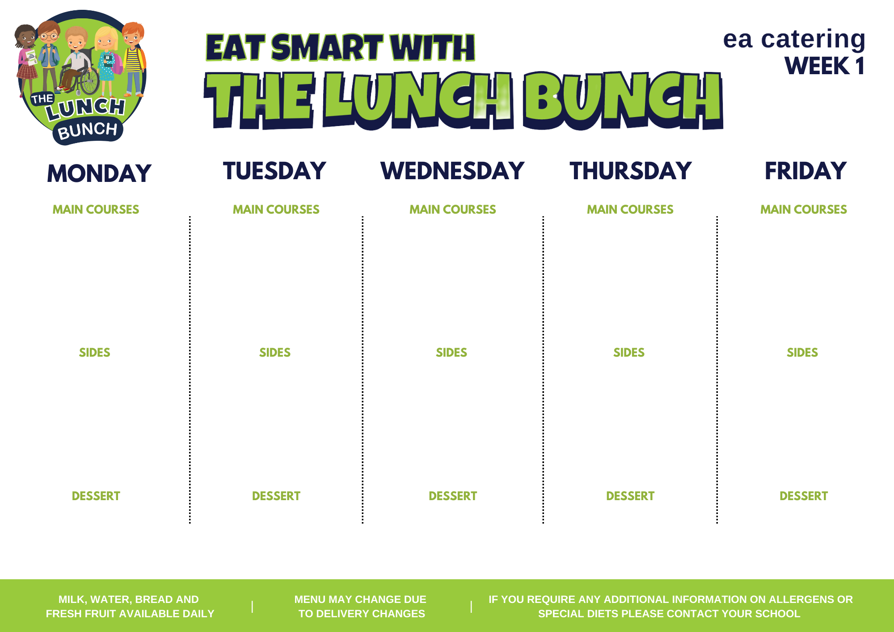
Week commencing
AUG 28, SEPT 25, OCT 23, NOV 20, DEC 18, JAN 22
Savoury Mince
Or
Italian Chicken & Tomato Pasta & Garlic Bread
Classic Margherita
Pizza
Or
Fish Goujon in Soft Shell Taco & Zingy Tomato Salsa
Lunch Bunch Chicken Curry & Naan Bread
Or
Chicken Panini
Roast of the Day
Or
Chicken Casserole
Hot Dog
Or
Crispy Cod Fishcakes
Baton Carrot/Salad
Mashed Potatoes
Baked Beans/Salad/Coleslaw
Chipped Potatoes/ Baked Potato
Garden Peas/Sweetcorn
Steamed Rice/Oven Baked Wedges
Carrots & Parsnip/Savoy Cabbage
Mashed Potatoes/Oven Roast Potato
Tomato Ketchup/Coleslaw/Salad
Chipped Potatoes/Baked Potato
Banana Yoghurt Pot
Strawberry Mousse & Fruit
Chocolate Sponge & Custard
Strawberry Jelly, Ice Cream & Fruit
Fresh Fruit Pot & Biscuit

Slide 2
WEEK COMMENCING:
SEP 04, OCT 02, OCT 30,
NOV 27, JAN 01, JAN 29
Sausage Roll
Or
Sweet and Sour Chicken
Pasta Bolognaise with Garlic Bread
Or
BBQ Chicken Pizza
Lunch Bunch Chicken Curry & Naan Bread
Or
Salad filled Pitta with Pulled Pork and Coleslaw
Roast of the Day
Or
Poached Salmon
Beef Burger in a Bap with Tomato Ketchup
Or
Peppered Chicken
Spaghetti Hoops & Garden Peas
Chipped Potatoes/Steamed Rice
Sweetcorn/Salad
Oven Roasted Potato Wedges
Garden Peas
Steamed Rice
Cauliflower or Broccoli and Carrots
Mashed Potatoes/Oven Roasted Potato
Sweetcorn/Salad
Chipped Potatoes/Steamed Rice
Ice Cream, Chocolate Sauce and Sliced Pears
Zesty Orange Sponge & Custard
Fresh Fruit Salad and Yoghurt
Blueberry
Muffin
Flakemeal Biscuit & Fruit

Slide 3
WEEK COMMENCING:
SEP 11, OCT 9, NOV 6,
DEC 4, JAN 8, FEB 5
Golden Crumbed Fish Fingers
Or
Mighty Mac ‘n’ Cheese with Garlic Bread Slice
Italian Beef with Crusty Roll
Or
Pepperoni/Margherita Pizza
Lunch Bunch Chicken Curry & Naan Bread
Or
Steak Burger in a Bap & Cheese
Roast of the Day
Or
Savoury Mince
Tasty Pork Sausages with Tomato Ketchup/Gravy
Or
Salt N Chilli Chicken Wrap with Garlic Mayo
Baked Beans/Coleslaw
Chipped Potatoes/Mashed Potatoes
Garden Peas/Salad
Homemade Diced Potatoes
Steamed Rice/Salad
Carrot & Parsnip/Cauliflower Cheese
Mashed Potatoes/Oven Roast Potato
Mini Corn on the Cob/Spaghetti Hoops
Chipped Potatoes/Mashed Potatoes
Artic Roll with Peaches & Pears
Fresh Fruit Pot
Lemon Drizzle Cake & Custard
Melon Wedge
Decorated Fairy Cake

Slide 4
WEEK COMMENCING:
SEP 18, OCT 16, NOV 13,
DEC 11, JAN 15, FEB 12
Beef Bolognaise with Garlic Bread
Or
Cod Fishcakes with Tartare Sauce
Ham & Cheese Pizza or Pepperoni with Garlic Dip
Or
Tex Mex Beef & Veg Enchilada
Lunch Bunch Chicken Curry & Naan Bread
Or
BBQ Chicken Wrap with Crunchy Salad
Roast of the Day
Or
Stuffed Chicken
Oven Baked Chicken Goujons
Or
Sweet Chilli Chicken Panini
Garden Peas
Oven Baked Potato Wedges
Sweetcorn and Red Pepper/Coleslaw
Chipped Potatoes/Baked Potato
Green Beans
Steamed Rice
Broccoli/Turnip
Mashed Potatoes/Oven Roast Potato
Salad/Baked Beans
Chipped Potatoes/Mashed Potatoes
Melon, Mandarin & Pineapple Pots with Yoghurt Dip
Jelly & Mandarin Oranges
Cornflake Tart & Custard
Ice Cream, Pears & Chocolate Sauce
Homemade Ginger Biscuit and Fruit

