Slide 1
PEOPLE WHO HELP US

Slide 2
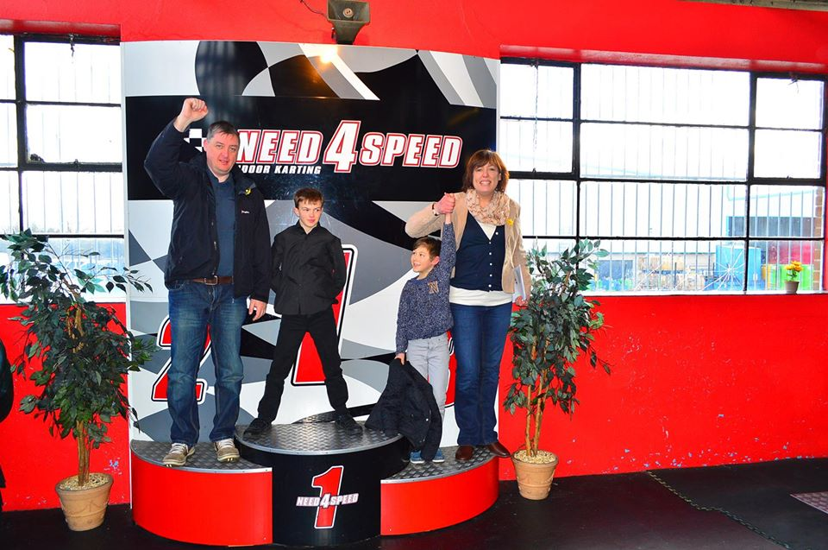
Family
We look after each other
My dad goes to work to earn money
My mum cooks all our meals
My brother taught me to ride a bike
I walk the dog and cut the grass
Together we have fun and good times

Slide 3
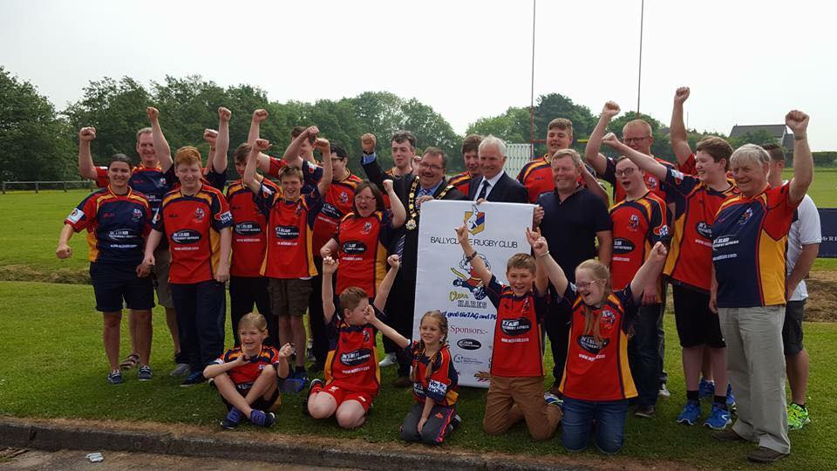
Friends
We play together
We celebrate together
We learn new things from each other
We encourage each other to do our best
We help each other when we are upset
We look forward to seeing each other

Slide 4
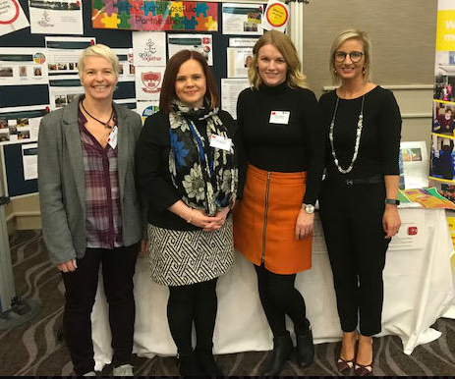
Teachers
They help us to learn
They let us make mistakes
They teach us to read
We learn to listen
They tell us off when we are being silly
They reward us when we are good and when we succeed

Slide 5
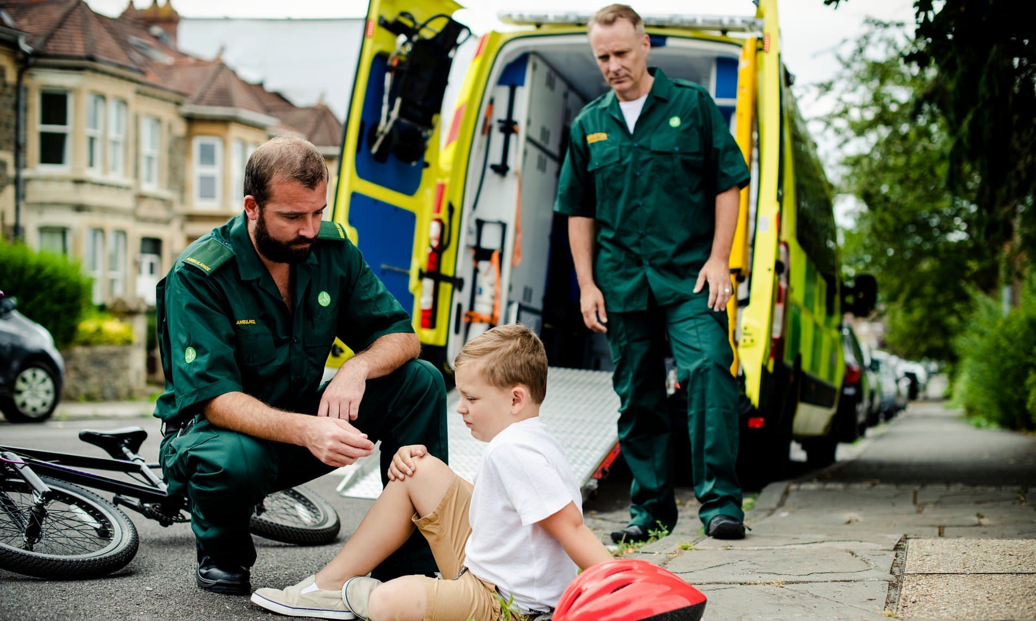
Paramedics
They are an emergency service
They arrive quickly
They give you medicine for pain
They can save your life
They take you to hospital
They travel in ambulances

Slide 6
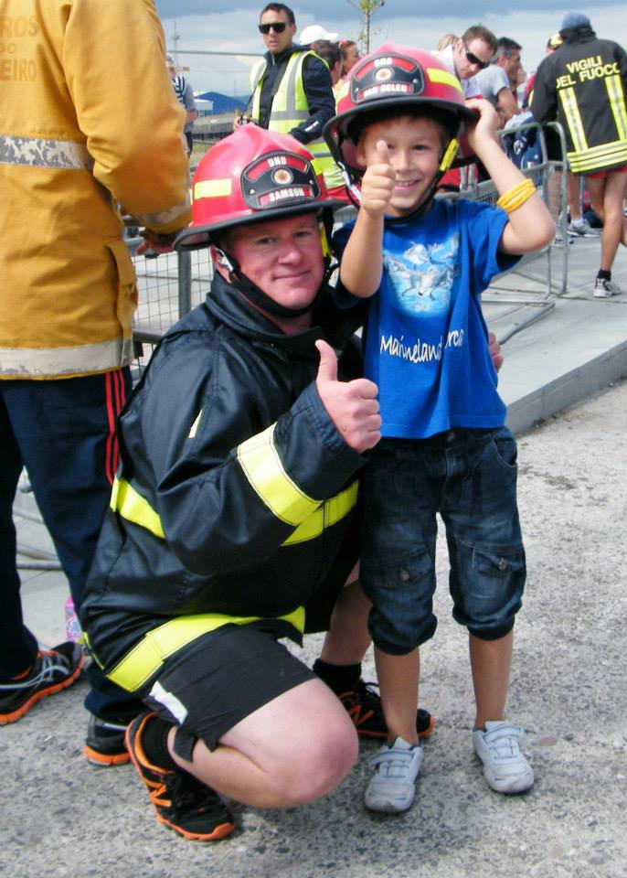
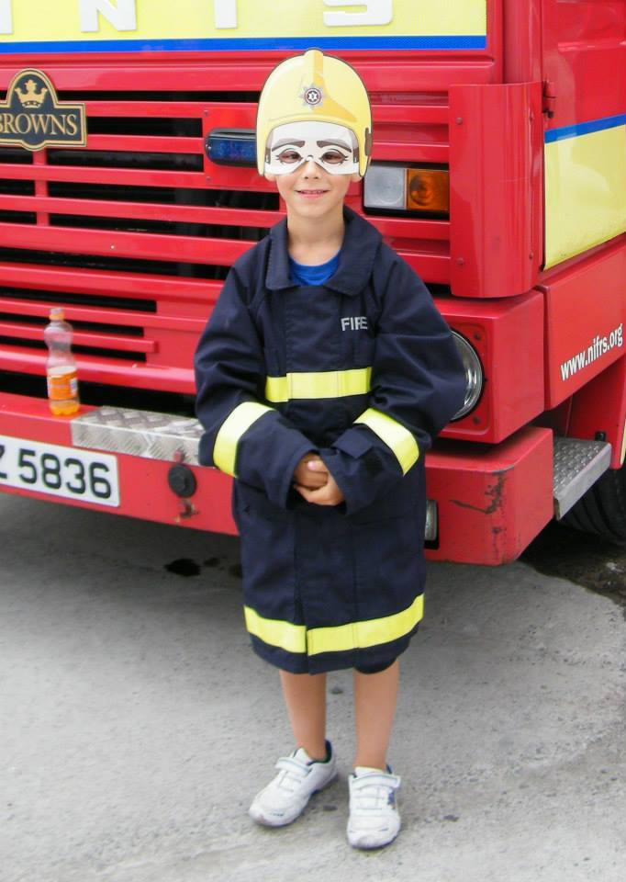
Fire Brigade
They rescue people from fires
They use fire engines to travel quickly
They put out fires
They can save cats from trees
They teach us how to be safe
They can cut through cars in a traffic accident to save someone

Slide 7
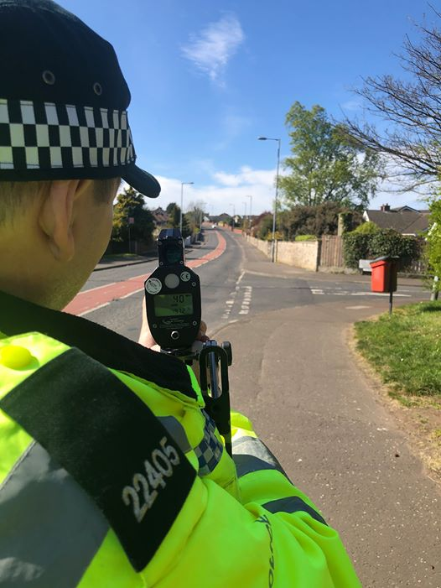
Police
They keep us safe from crime
They arrest people who break the law
They check car speeds
They use handcuffs
They check if people carry weapons
They look for drugs
They break up fights
They solve crime

Slide 8
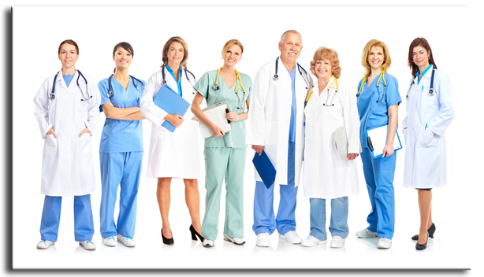
Doctors and Nurses
They make us better when we are sick
They fix broken bones
They check for illnesses and injuries
They give us medicine
They take our temperature
They give us injections

Slide 9
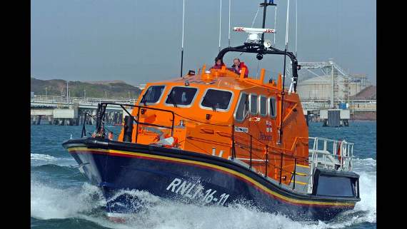
Lifeboat Volunteers
They rescue people at sea
They rush from home to the lifeboat station
They wear waterproof clothes and life jackets
They use boats to reach the people in danger
They save people from drowning
They use walkie talkies
I want to volunteer with RNLI when I’m older

Slide 10
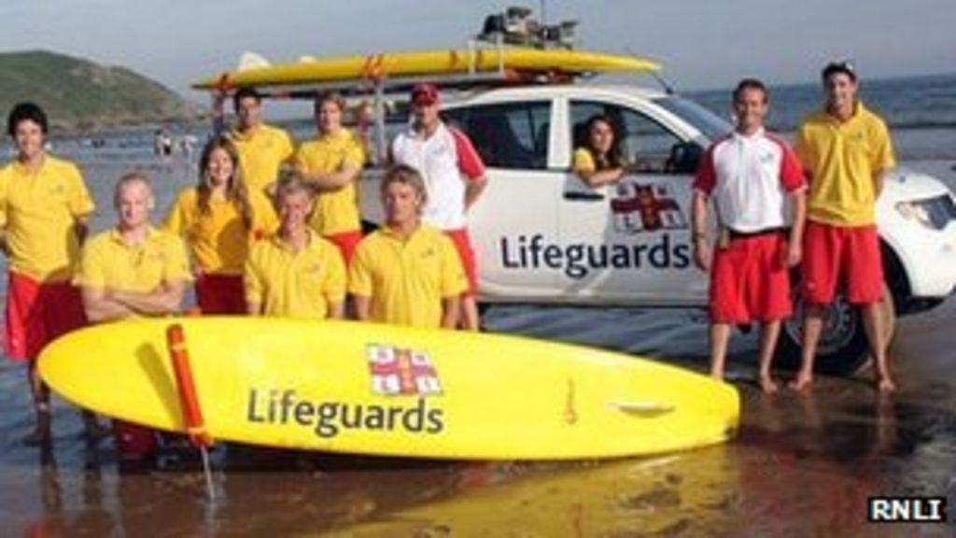
Lifeguards
They rescue people who are drowning
They work in swimming pools
They also work at the beach
They are strong swimmers
They tell us to be careful
The pull people out of the water
They can save lives

